Slide 1
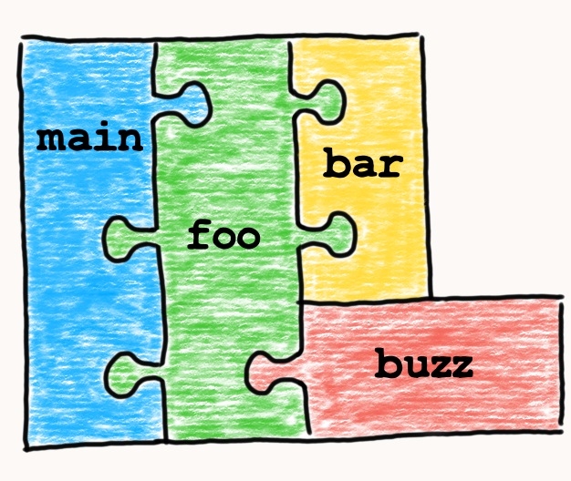
What do I think while designing an API/Function?

Slide 2
Who am I?
Practicing software engineering for more than a decade.
C++ is my first programming language
Also interested in other technologies and languages
Interested in IOT, Cloud and Security technologies
Founder and one of the organizers of CppIndia
Dheeraj Jha
Senior Professional II @ Capgemini Engineering
Email: contact@jhadheeraj.com
Web: www.jhadheeraj.com
LinkedIn: www.linkedin.com/in/jhadheeraj
Twitter: @dheerajjha03

Slide 3
What is an API?
An API is simply a description of how to interact with a component.
provides an abstraction
provides functional specification for a component
An API is a logical interface to a software component that hides the internal details required to implement it.
Notes:
C++ APIs generally includes Header, Libraries and Documentations.
An API describes your software used by other engineers to build their applications. So, your API must be well-designed, documented, regression tested, and stable between releases

Slide 4
Why Should You Write APIs?
More Robust Code
Code Reuse
Hides implementation
Parallel Development
Increases longevity
Promotes modularization
Reduces code duplication
Easier to change the implementation
Easier to optimize
Notes:
Hides implementation: By hiding the implementation details of your module, you gain the flexibility to change the implementation at a future date without causing upheaval for your users.
Increases longevity: Over time, systems that expose their implementation details tend to devolve into spaghetti code where every part of the system depends on the internal details of other parts of the system.
Promotes modularization: Developing an application on top of a collection of APIs promotes loosely coupled and modular architectures where the behaviour of one module is not dependent on the internal details of another module.
Reduces code duplication: By keeping all of your code’s logic behind a strict interface that all clients must use, you centralize the behaviour in a single place.
Easier to change the implementation: If you have hidden all of the implementation details of your module behind its public interface then you can change those implementation details without affecting any code that depends on the API.
Easier to optimize: with your implementation details hidden successfully, you can optimize the performance of your API without requiring any changes to your clients’ code.

Slide 5
What are the basic qualities of a good API?

Slide 6
Model the Problem Domain
Make sense in the chosen problem domain.
A non-programmer should be able to understand the concepts of the interface.
Notes:
MODEL THE PROBLEM DOMAIN
Provide a Good Abstraction
It should be formulated in terms of high-level concepts that make sense in the chosen problem domain rather than exposing low-level implementation issues.
You should be able to give your API documentation to a non-programmer and that person should be able to understand the concepts of the interface and how it is meant to work.

Slide 7
Hide Implementation Details
Physical Hiding: Declaration versus Definition
Logical Hiding: Encapsulation
Hide Implementation Methods
Hide Implementation Classes
Hide Member Variables
Notes:
Physical Hiding: Physical hiding means storing internal details in a separate file (.cpp) from the public interface (.h).
Logical Hiding:
* The object-oriented concept of encapsulation provides a mechanism for limiting access to members of an object.
* Public/Protected/Private
* Encapsulation is the process of separating the public interface of an API from its underlying implementation.
* Logical hiding means using the C++ language features of protected and private to restrict access to internal details.
Hide Member Variables:
Validation
Lazy evaluation
Caching
Extra computation
Notifications
Debugging
Synchronization
Finer access control.
Maintaining invariant relationships
member variables should never be public, as well as protected. If you make a variable protected, then it can be accessed directly by any clients that subclass your class, and then exactly the same arguments apply as for the public case
As Alan Snyder states, inheritance severely compromises the benefits of encapsulation in object-oriented programming languages (Snyder, 1986).
Executing a C++ function call incurs the overhead of pushing the method’s parameters and return address onto the call stack, as well as reserving space for any local variables in the routine. Then when the method completes, the call stack has to be unwound again.
Hide Implementation Methods
The key point to remember is that a class should define what to do, not how it is done
Never return non-const pointers or references to private data members. This breaks encapsulation.
Prefer declaring private functionality as static functions within the .cpp file rather than exposing them in public headers as private methods. (Using the Pimpl idiom is even better though.
Hide Implementation Classes
In addition to hiding the internal methods and variables for your classes, you should also endeavor to hide any actual classes that are purely implementation detail.

Slide 8
Minimally Complete
A good API should be minimally complete
should be as small as possible
API should be complete
Don’t Overpromise
Add Virtual Functions Judiciously
Convenience APIs
Notes:
To answer this question you will have to perform requirements gathering and use case modelling early on so that you understand what the API is expected to do
a compact interface is one that can easily fit inside the head of your users
Don’t Overpromise :
The key point is that once you release an API and have clients using it, adding new functionality is easy, but removing functionality is really difficult.
When in doubt, leave it out! Minimize the number of public classes and functions in your API.
Add Virtual Functions Judiciously
There are chances that you might add some features or add some small changes in your base class but you will do that without knowing your clients are use your API. That might break client's code.
You might have exposed some thread-safe APIs but client can override it in some unsafe way without performing any proper locking.
A class with no virtual functions tends to be more robust and requires less maintenance than one with virtual functions.
If you still decide that you want to allow subclassing, make sure that you design your API to allow it safely. Remember the following rules:
Always declare your destructor to be virtual if there are any virtual functions in your class. This is so that subclasses can free any extra resources that they may have allocated.
Always document how methods of your class call each other. If a client wants to provide an alter- native implementation for a virtual function, they will need to know which other methods need to be called within their implementation in order to preserve the internal integrity of the object.
Never call virtual functions from your constructor or destructor. These calls will never be directed to a subclass (Meyers, 2005). This does not affect the appearance of your API, but it’s a good rule to know all the same.
Convenience APIs
encapsulate multiple API calls to provide simpler higher-level operations
The important point is that you do not mix your convenience API in the same classes as your core API.
Instead, you can produce supplementary classes that wrap certain public functionality of your core API.
Add convenience APIs as separate modules or libraries that sit on top of your minimal core API.

Slide 9
Easy To Use
A well-designed API should make simple tasks easy and obvious.
Difficult to Misuse
Consistent
Orthogonal
Robust Resource Allocation
Platform Independent
Notes:
EASY TO USE
A well-designed API should make simple tasks easy and obvious.
it should make the task of writing documentation much easier.
Difficult to Misuse
A good API, in addition to being easy to use, should also be difficult to misuse.
Prefer enums to booleans to improve code readability. Preferably use enum class
Avoid functions with multiple parameters of the same type.
Consistent
A good API should apply a consistent design approach so that its conventions are easy to remember, and therefore easy to adopt
consistent naming conventions imply reuse of the same words for the same concepts across the API
Use consistent function naming and parameter ordering.
the easiest APIs to use are those that require minimal new learning for your users.
Orthogonal
An orthogonal API means that functions do not have side effects.
Calling a method that sets a particular property should change only that property and not additionally change other publicly accessible properties.
Reduce redundancy. Ensure that the same information is not represented in more than one way. There should be a single authoritative source for each piece of knowledge.
Robust Resource Allocation
most C++ bugs arise from some kind of misuse of pointers or references, such as
Null dereferencing: trying to use -> or * operators on a NULL pointer.
Double freeing: calling delete or free() on a block of memory twice.
Accessing invalid memory: trying to use -> or * operators on a pointer that has not been allocated yet or that has been freed already.
Mixing Allocators: using delete to free memory that was allocated with malloc() or using free() to return memory allocated with new.
Incorrect array deallocation: using the delete operator instead of delete [] to free an array.
Memory leaks: not freeing a block of memory when you are finished with it.
Platform Independent
A well-designed C++ API should always avoid platform-specific #if/#ifdef lines in its public headers.
Never put platform-specific #if or #ifdef statements into your public APIs. It exposes implementation details and makes your API appear different on different platforms.

Slide 10
Loosely Coupled
Good software designs tend to correlate with low (or loose) coupling and high cohesion.
Good APIs exhibit loose coupling and high cohesion.
Coupling by Name Only
Reducing Class Coupling
Callbacks, Observers, and Notifications
Notes:
Various measures can be used to evaluate the degree of coupling between
components.
Size. Relates to the number of connections between components, including the number of classes, methods, arguments per method, etc. For example, a method with fewer parameters is more loosely coupled to components that call it.
Visibility. Refers to the prominence of the connection between components. For example, changing a global variable in order to affect the state of another component indirectly is a poor level of visibility.
Intimacy. Refers to the directness of the connection between components. If A is coupled to B and B is coupled to C, then A is indirectly coupled to C. Another example is that inheriting from a class is a tighter coupling than including that class as a member variable (composition) because inheritance also provides access to all protected members of the class.
Flexibility. Relates to the ease of changing the connections between components. For example, if the signature of a method in ObjectA needs to change so that ObjectB can call it, how easy is it to change that method and all dependent code.
Coupling by Name Only
If class A only needs to know the name of class B, that is, it does not need to know the size of class B or call any methods in the class, then class A does not need to depend on the full declaration of B. In these cases, you can use a forward declaration for class B, rather than including the entire interface, and so reduce the coupling between the two classes
Callbacks, Observers, and Notifications
Callbacks
a callback is a pointer to a function within module A that is passed to module B so that B can invoke the function in A at an appropriate time.
Module B knows nothing about module A and has no include or link dependencies upon A. This makes callbacks particularly useful to allow low-level code to execute high-level code that it cannot have a link dependency on.
Observers
Notifications
An alternative solution is to build a centralized mechanism to send notifications, or events, between unconnected parts of the system.
STABLE, DOCUMENTED, AND TESTED
A well-designed API should be stable and future proof.

Slide 11

Thank You

